Slide 1
Skytrax
Feedback Sentiments

Slide 2
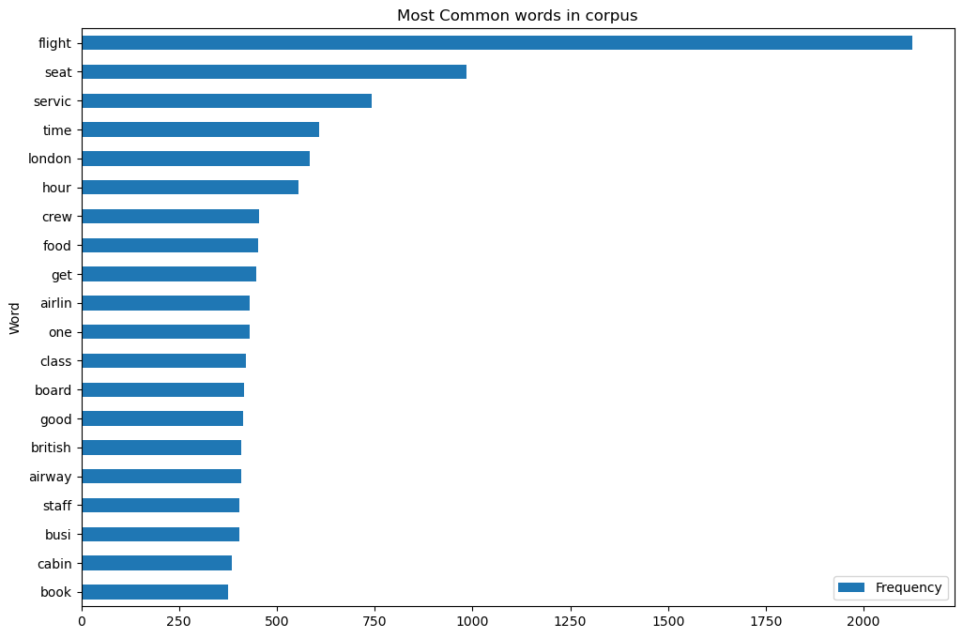
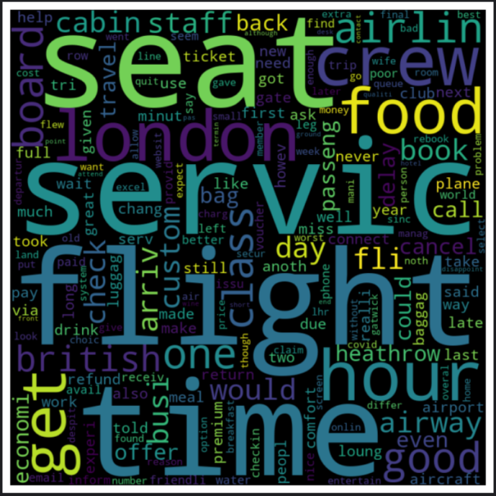
Terms with highest occurrence
The most commonly found terms in the reviews were show in the bar plot which gives an idea important aspects customers would notice.

